Slide 1
Data Science Lab - Assessment
Airbnb listing price model

Slide 2



Introduction

Slide 3



Introduction

Slide 4
Assessment details
“Predict the price of a new Airbnb listing”
22,552 records
96 columns
Approach
Step 1 – Online research
Step 4 – Variable elimination
Step 2 – Exploratory data analysis
Step 5 – Regression Modeling
Step 3 – Data processing & enhancing
Step 6 – Model assessment

Slide 5

Step 1 – Online research
Plenty of information online
Linear Regression
XGBoost
Ridge Regression

Slide 6
Step 1 – Online research
Plenty of information online
Linear Regression
XGBoost
RidgeRegression
Try a naive model as reference
Complexity later

Slide 7
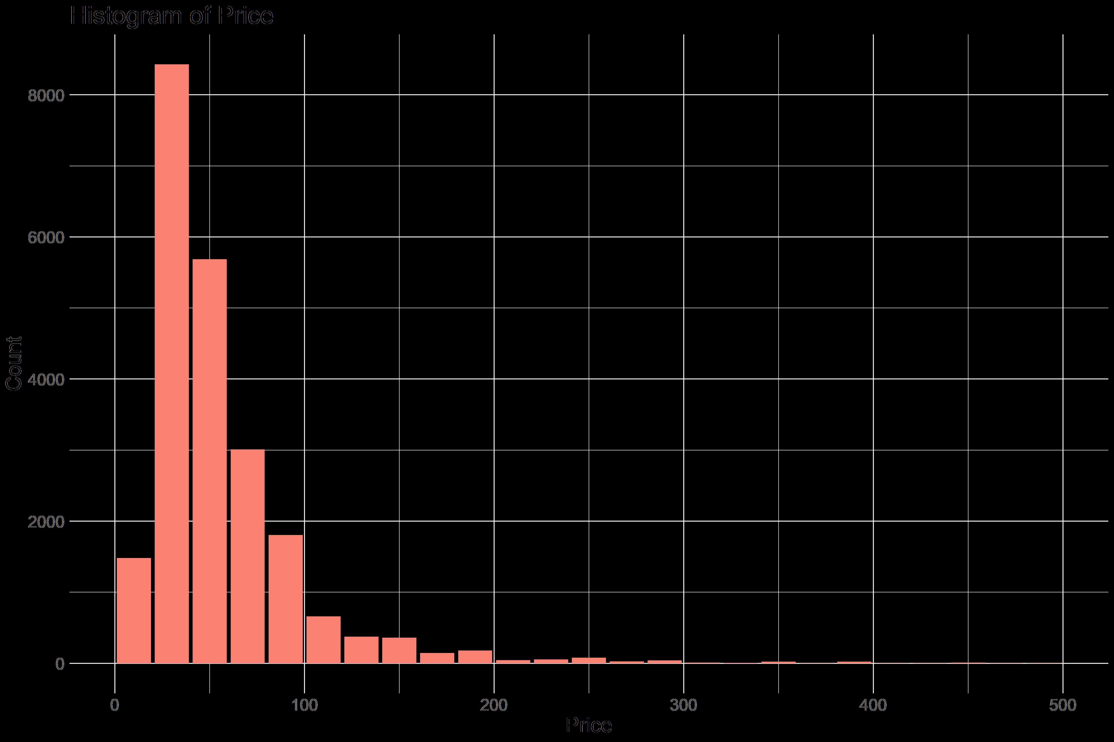
Step 2 – Exploratory data analysis
Exploratory data analysis consisted of:
Checking how many fields
Checking values and formats
Checking the distribution of some variables
And led to the following conclusions:
All listings are in Berlin and surroundings
Price is not normally distributed
Data cleaning will be needed
Data reformatting will be needed
“$60.31” 60.31
Latitude, Longitude Distance to Center

Slide 8
Step 3 – Data processing and enhancing
There are many reasons to exclude a variable:
Too many missing values
One unique value
No overlap in categorical values
This step excluded 39 variables
Column | Keep? | Reason
Price | Y | Dependent variable
... | ... | ...
Square_feet | N | 98% NAs
Has_availability | N | 1 unique value
... | ... | ...
Id | N | No overlap in values

Slide 9
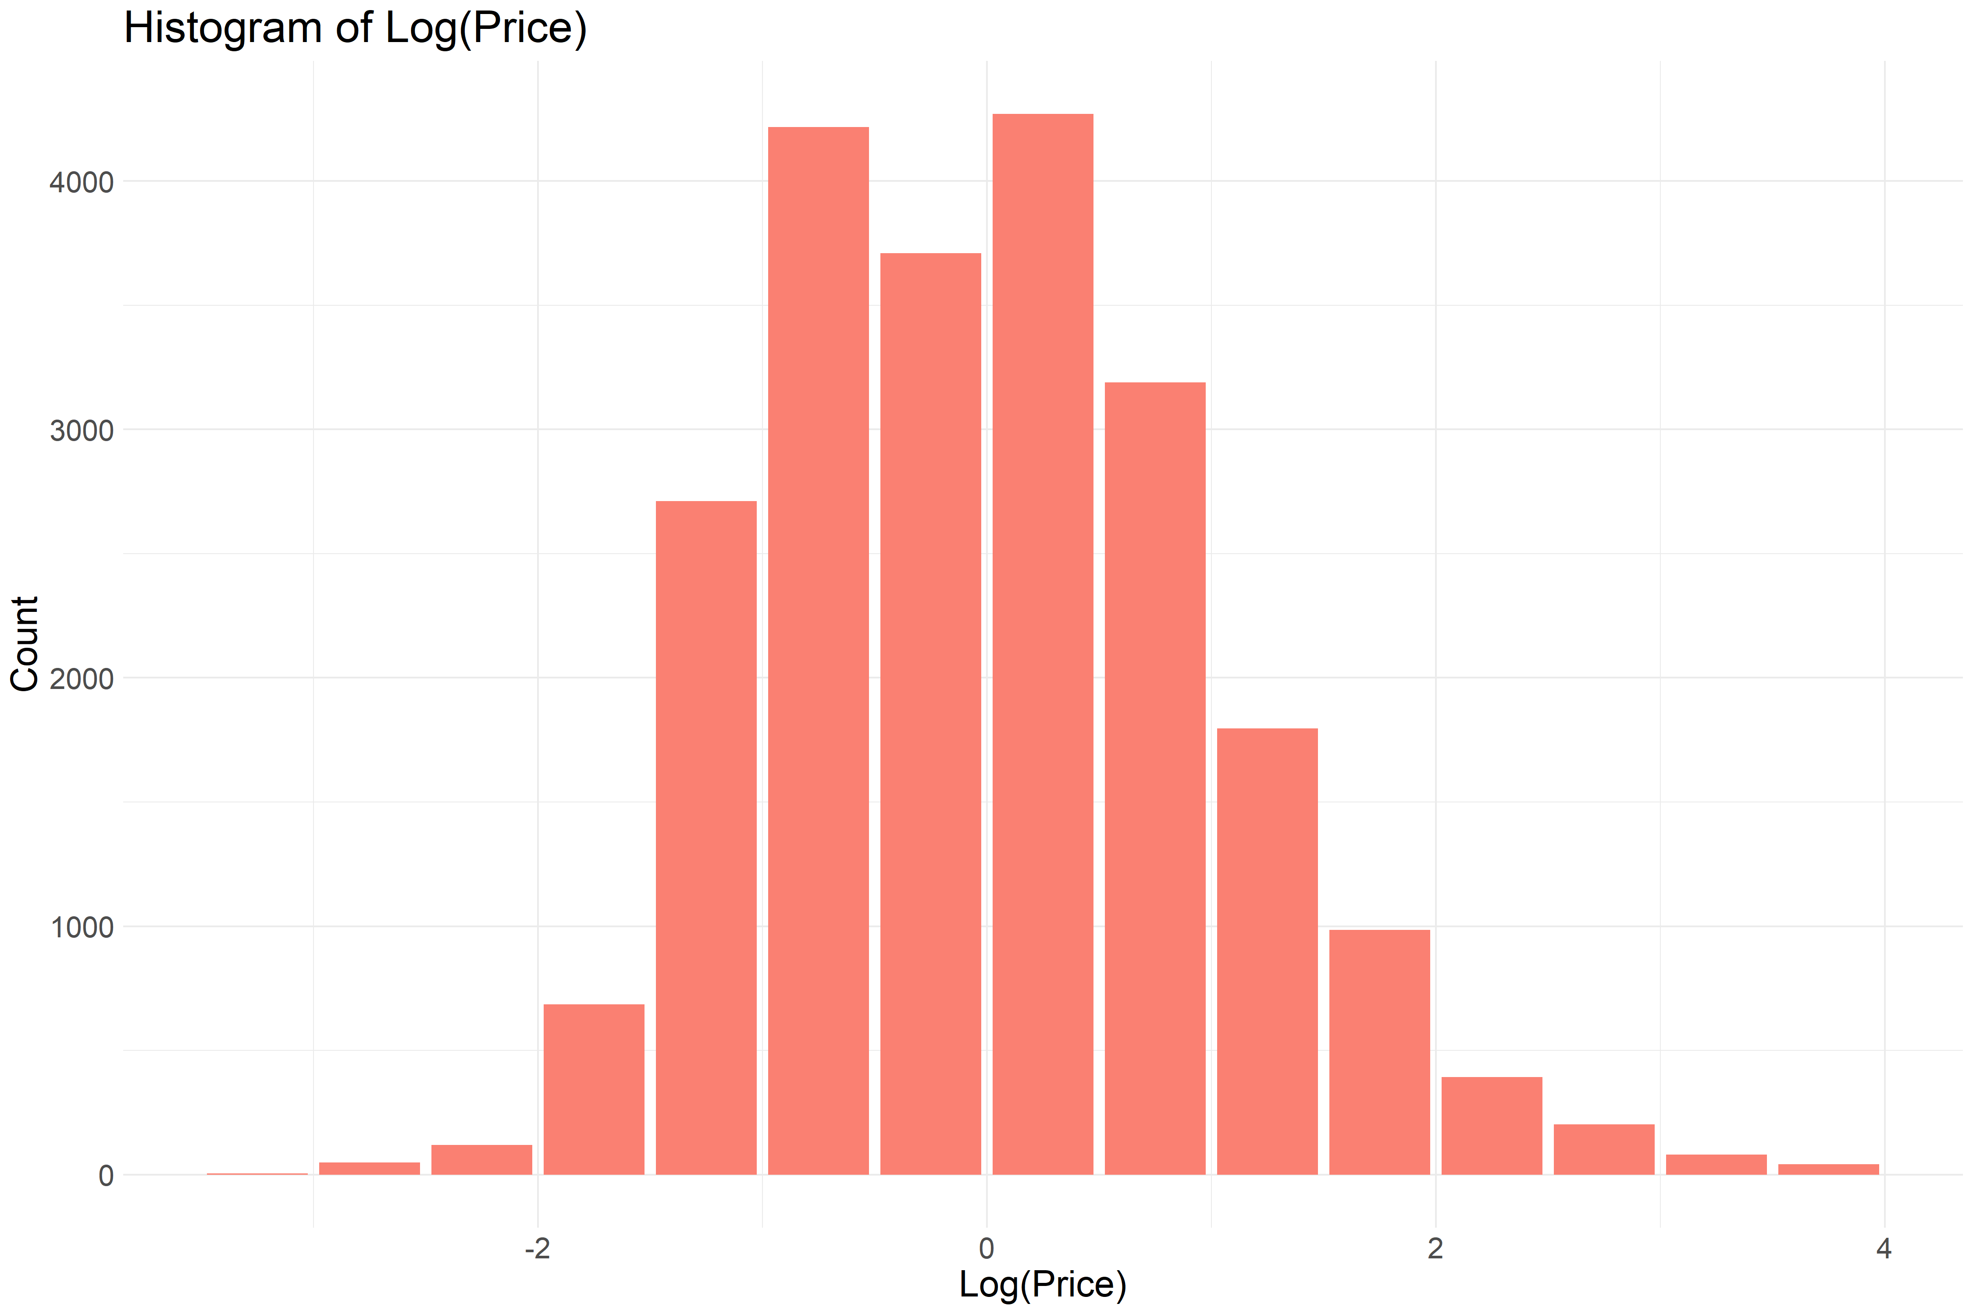
Step 3 – Data processing and enhancing
As part of the data enhancing
The dependent variable was changed
All numerical variables were standardized
Categorical fields were analyzed and refined
This created 16 additional
variables

Slide 10
Step 4 – Variable elimination
Variable elimination was conducted based on correlation
At the end, this left 23 variables for the simple regression and 36 for the complex version
No
High correlation with better variable?
No
Low correlation with price?
Variable
Candidate
Yes
Yes
Eliminated
Eliminated

Slide 11
Step 5 – Regression modeling
We start out with the MLR model for the naive model
The algorithm tries to minimize the error of each prediction and uses the R² metric as a performance measure
The flow of the regression calibration is as follows:
Start out with all variables and find the best fit
Eliminate the variable that contributes the least to the performance
Continue until there are only 5 variables left

Slide 12
Appendix
Airbnb listing price model

Slide 13
Appendix - Step 2 – Exploratory data analysis
96 columns - Dependent variable Price¹
Data type | Character | Categorical | Logical | Integer | Numerical | Date
# of columns | 20 | 14 | 10 | 22 | 10 | 4
Example column | description | bed_type | host_is_superhost | beds | price | first_review
Example value | “lovely apartment in...” | Pull-out sofa | t, f | 0,1,2,...,20 | 69.99 | ‘2015-01-01’

